Slide 1
The weekly sales went high in 2011. We can see that every year in the month of December the sales went high because of Holidays. Store number 20 is having highest number of sales Almost in every store ,department number 92 is having highest number of sales. Store number 12,28 and 38 have the highest number of unemployment rate. The problem that has rised in these stores should be resolved by consulting the workers or managers. Disclaimer – I have found this insights only using train data.

Slide 2
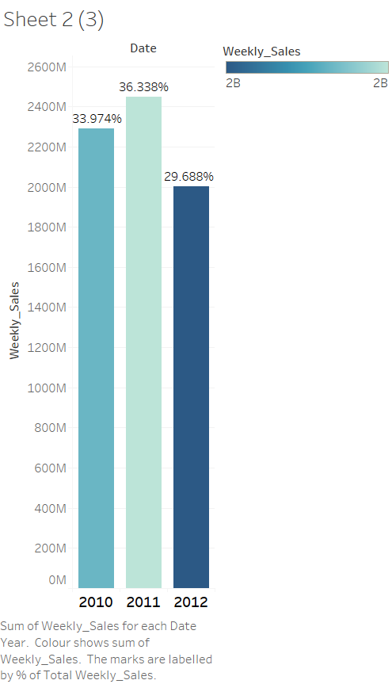
The weekly sales went high in 2011.

Slide 3
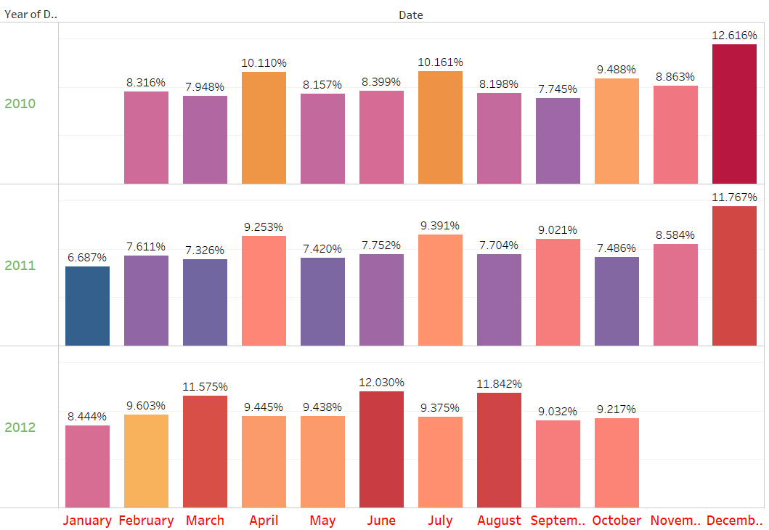
We can see that every year in the month of December the sales went high because of Holidays.

Slide 4
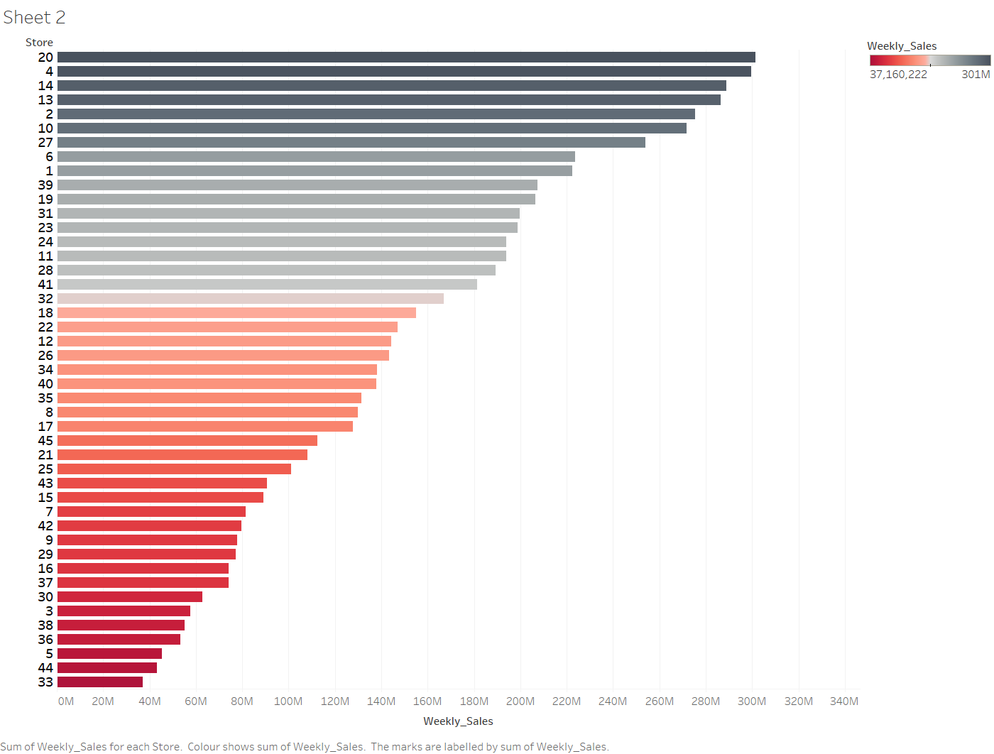
Store number 20 is having highest number of sales.

Slide 5
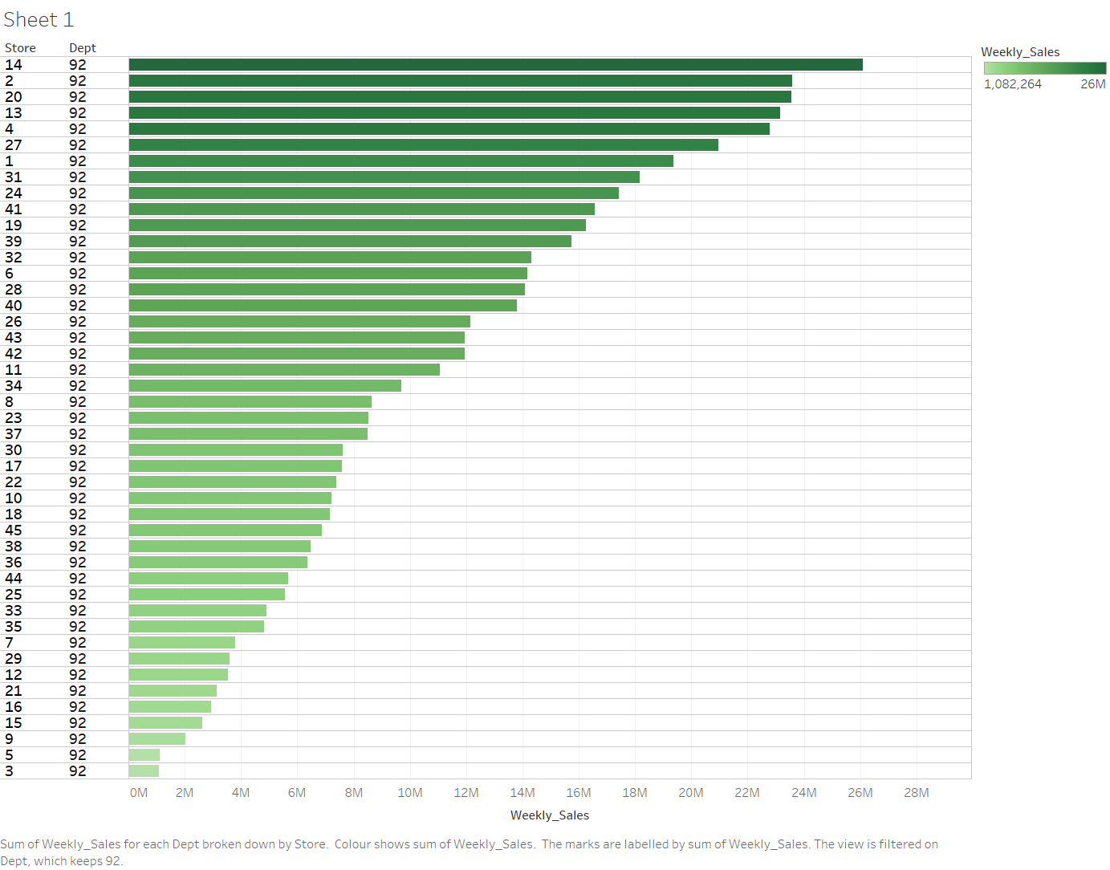
Almost in every store ,department number 92 is having highest number of sales.

Slide 6
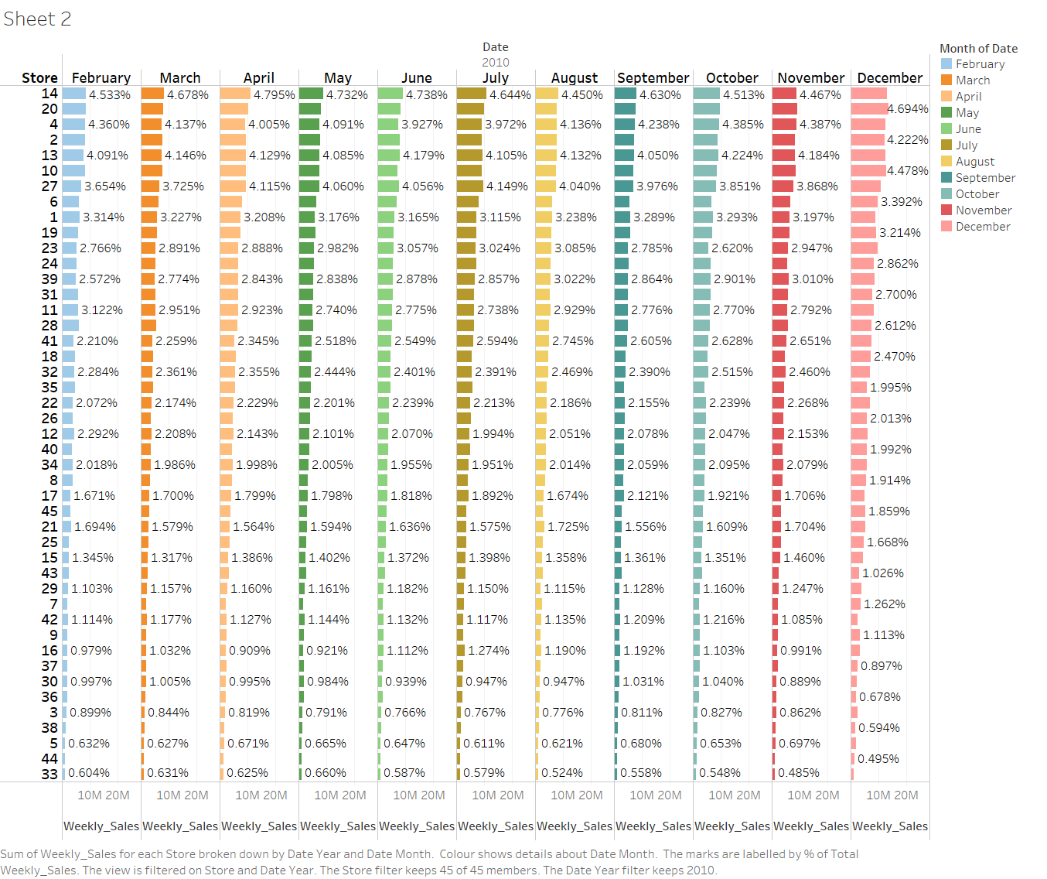
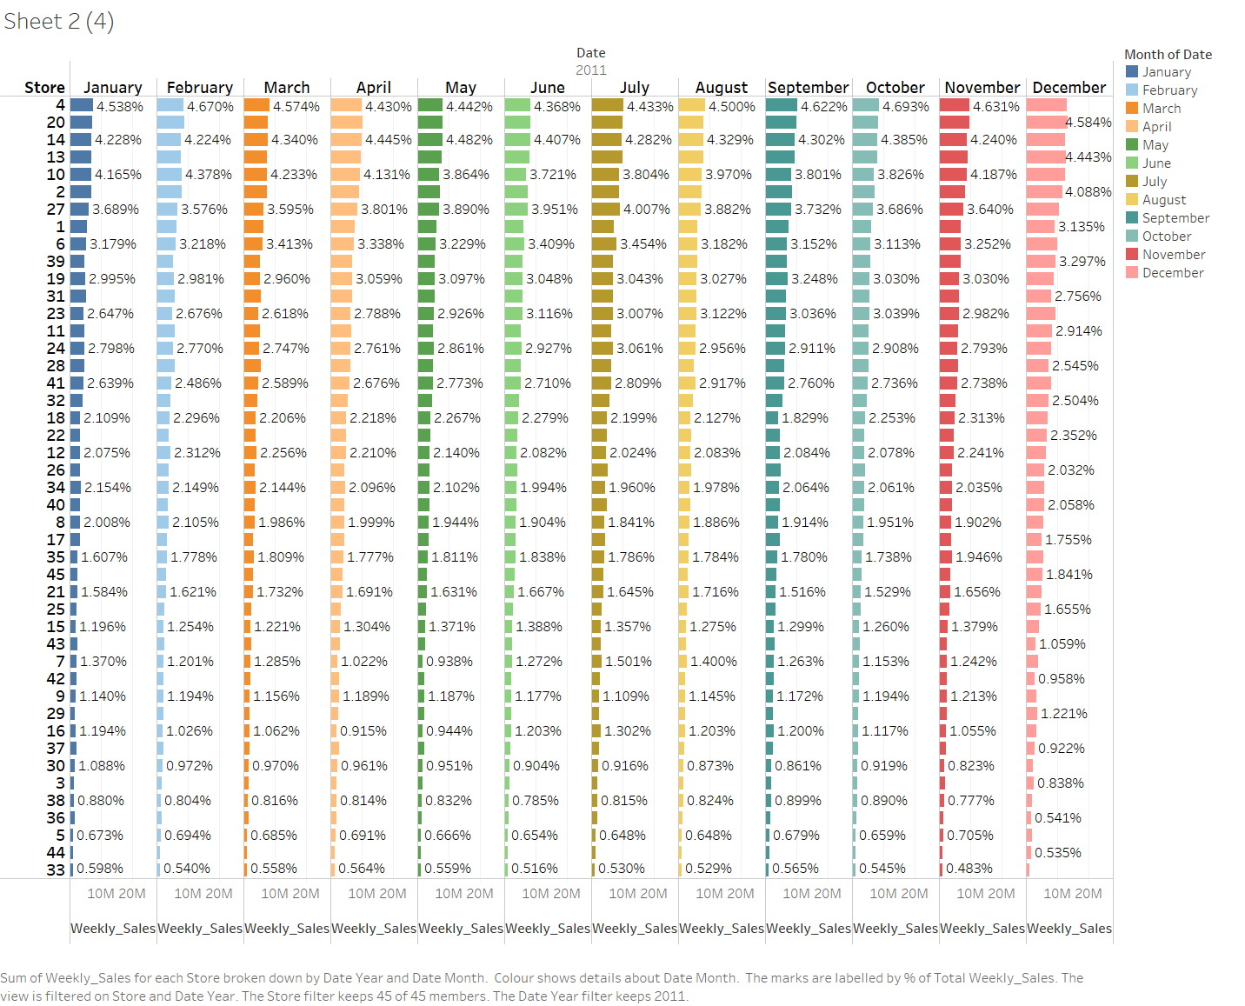
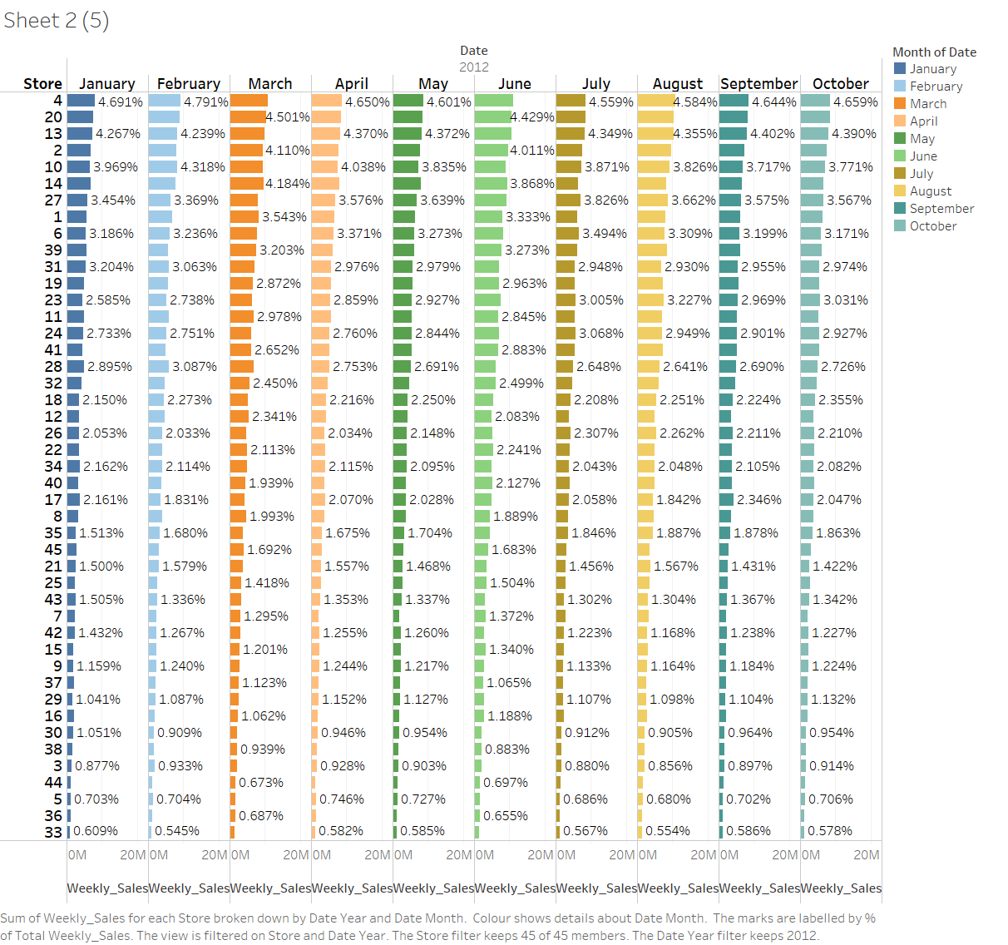
Comparing these three years, store number 4 has grown in terms of weekly sales.They have highest number of sales in the month of December.

Slide 7
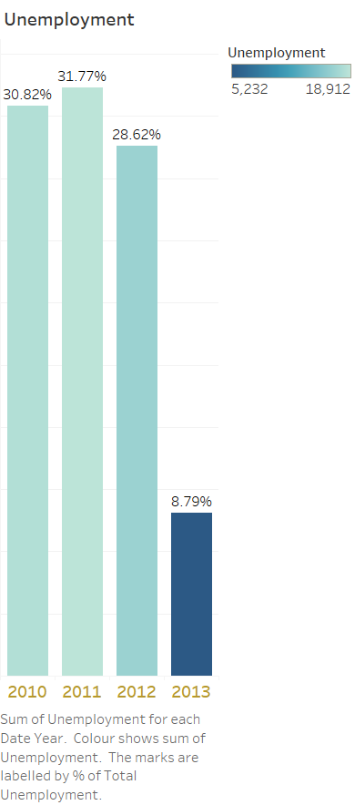
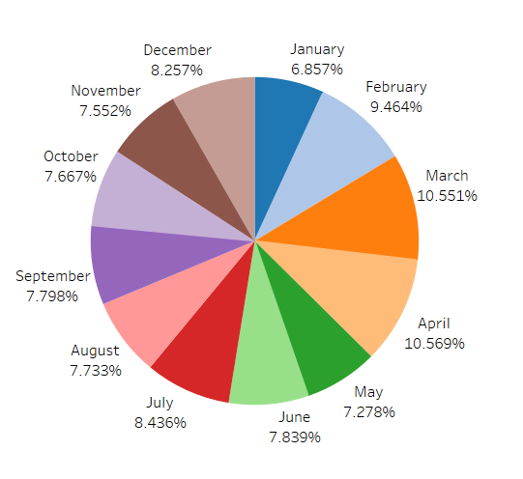
unEmployement rate has increased in the month of April.

Slide 8
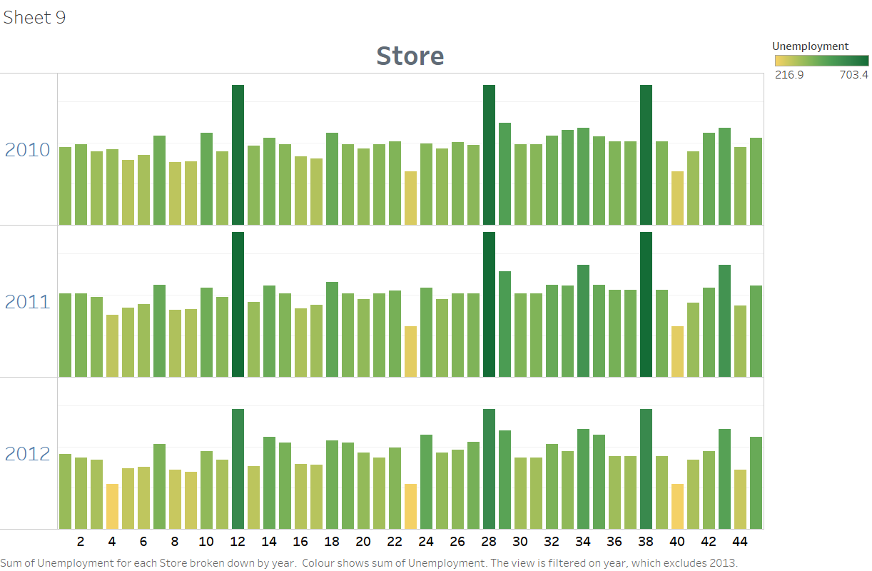
Store number 12,28 and 38 have the highest number of unemployment rate.

